Slide 1


Slide 2
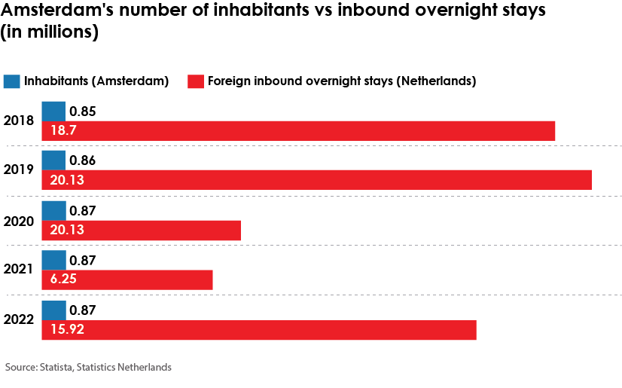
Amsterdam Tourism

Slide 3
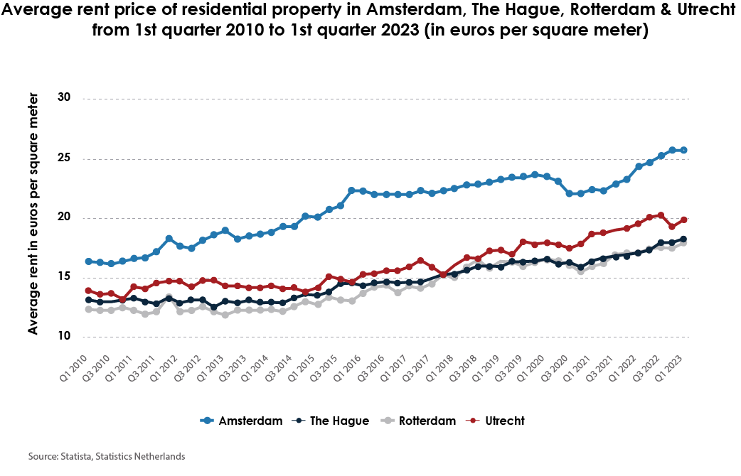
Airbnb issues

Slide 4

Amsterdam Airbnb Regulations
Listing must have permit & registration number
Listings cannot be rented for more than 30 nights a year
Listing must be the owners main residence
City of Amsterdam Must be notified of Booking
Cannot have multiple rental properties
Rent controlled units cannot be listed

Slide 5
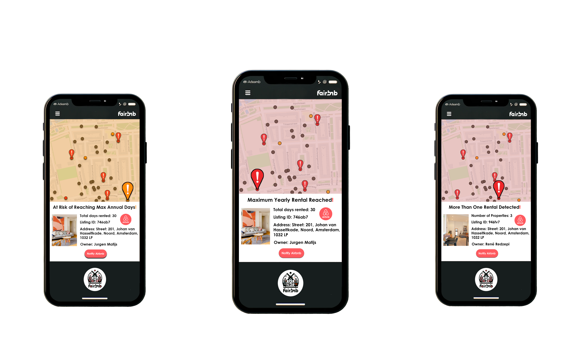
Fairbnb Use: Policy Regulation

Slide 6
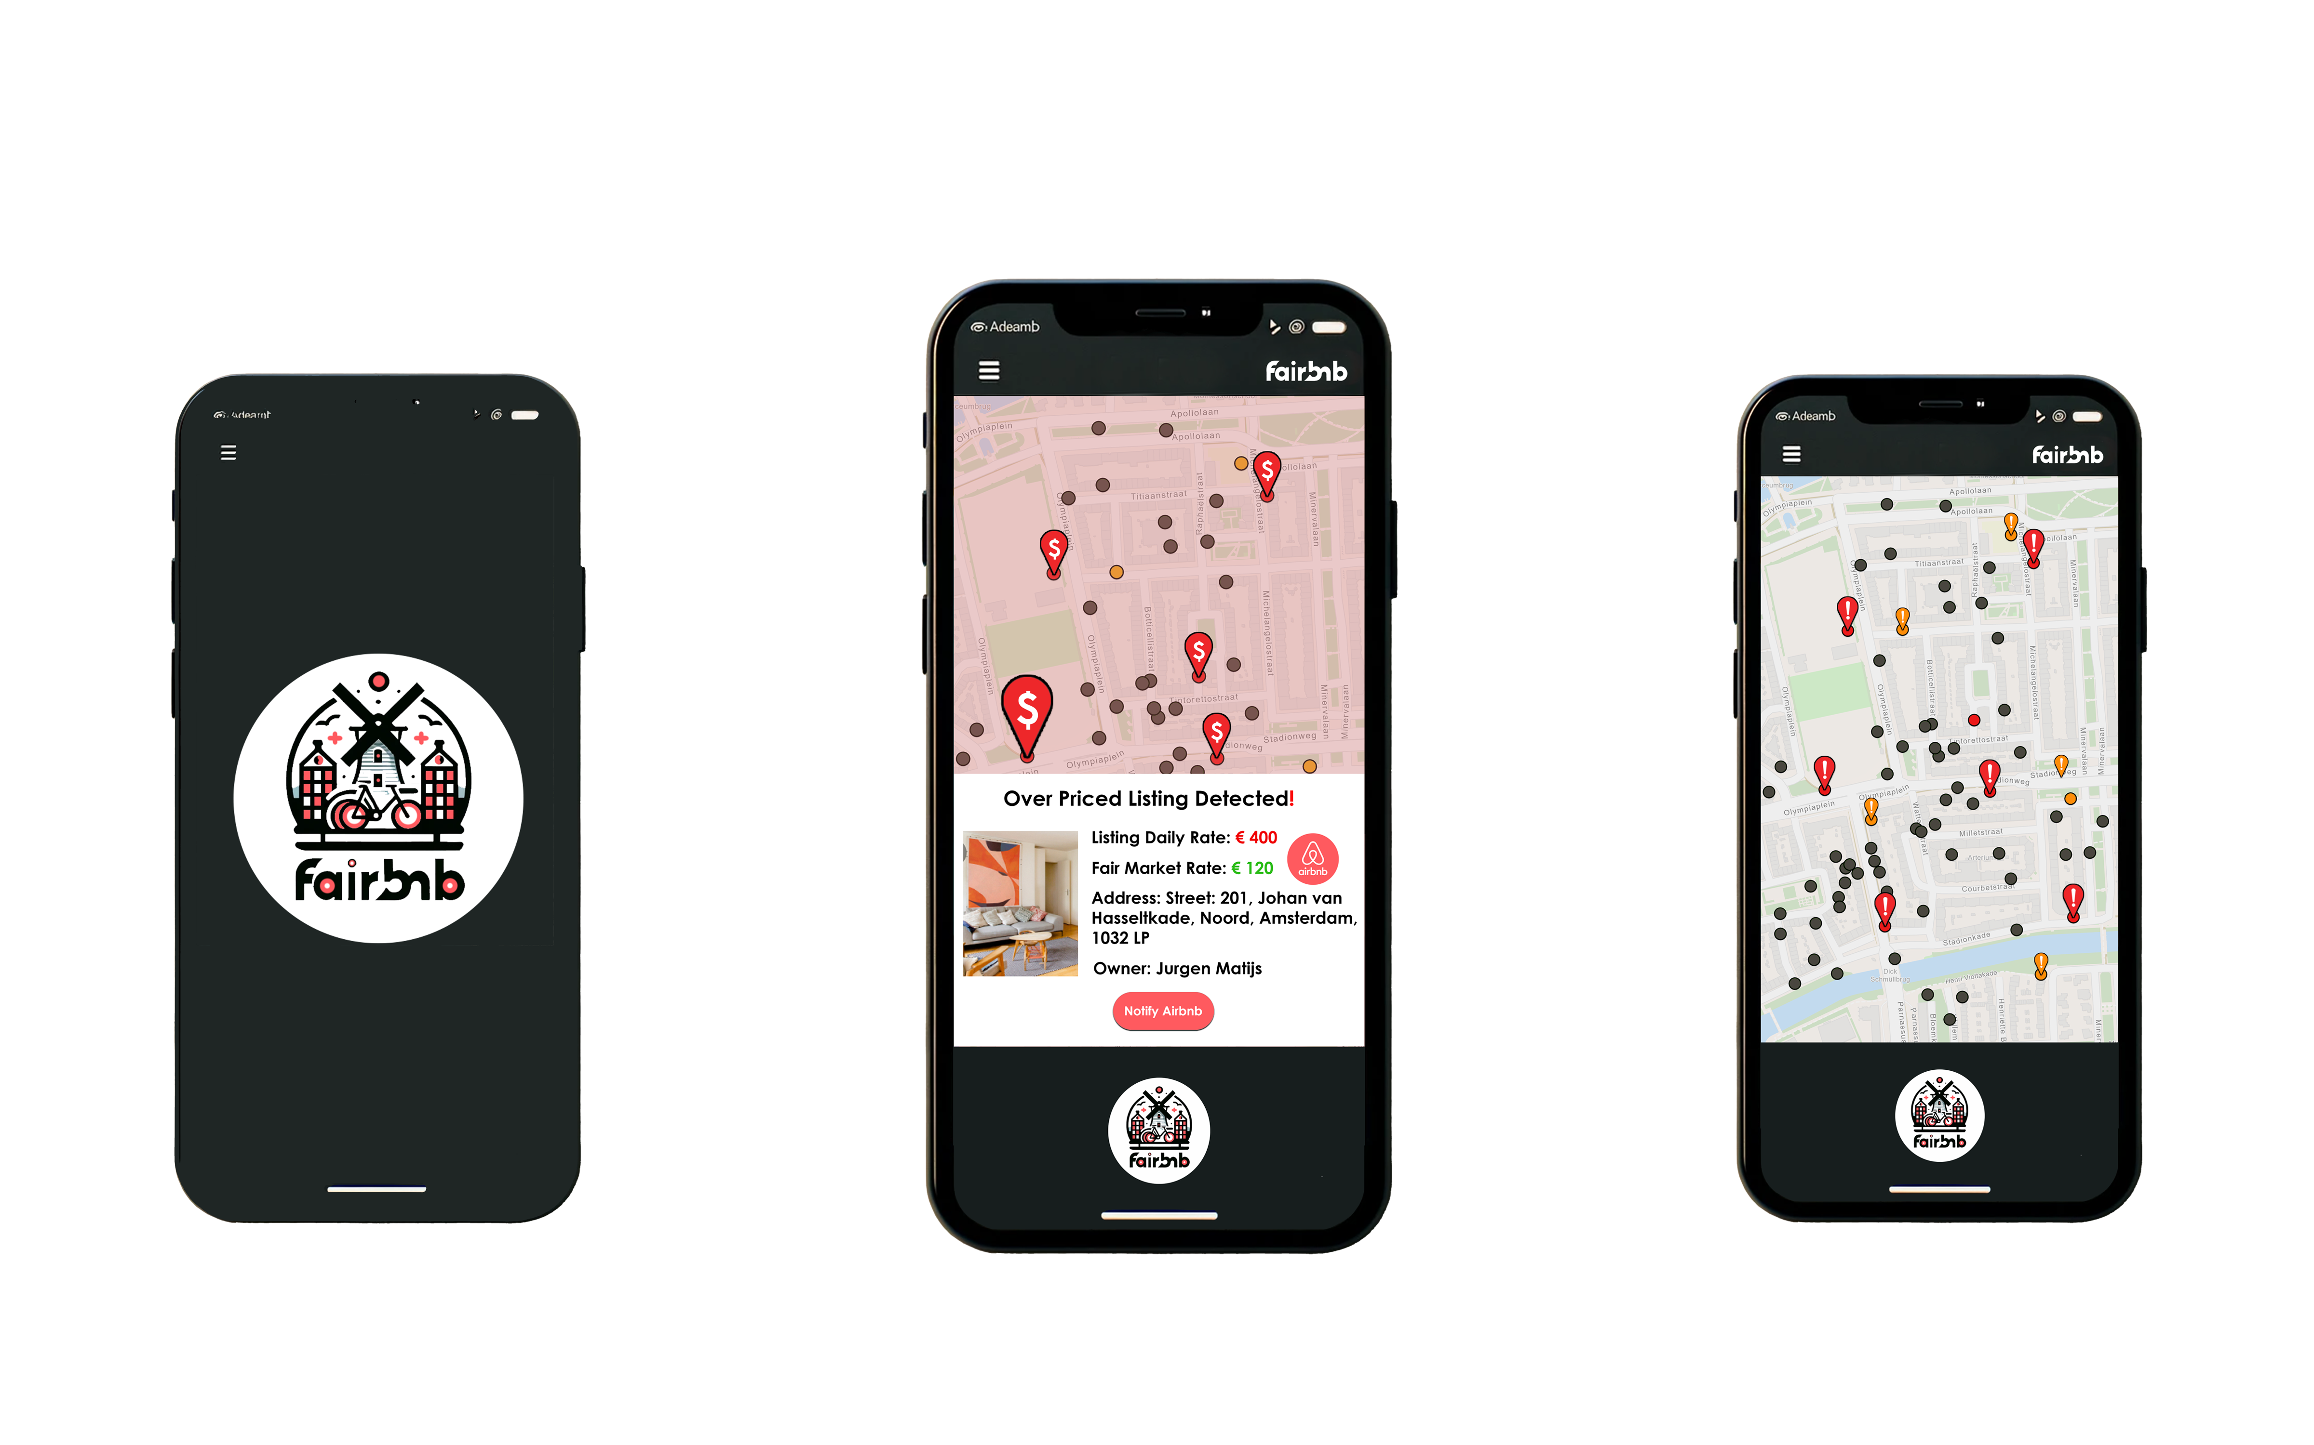
Fairbnb Use: Policy Recommendation

Slide 7
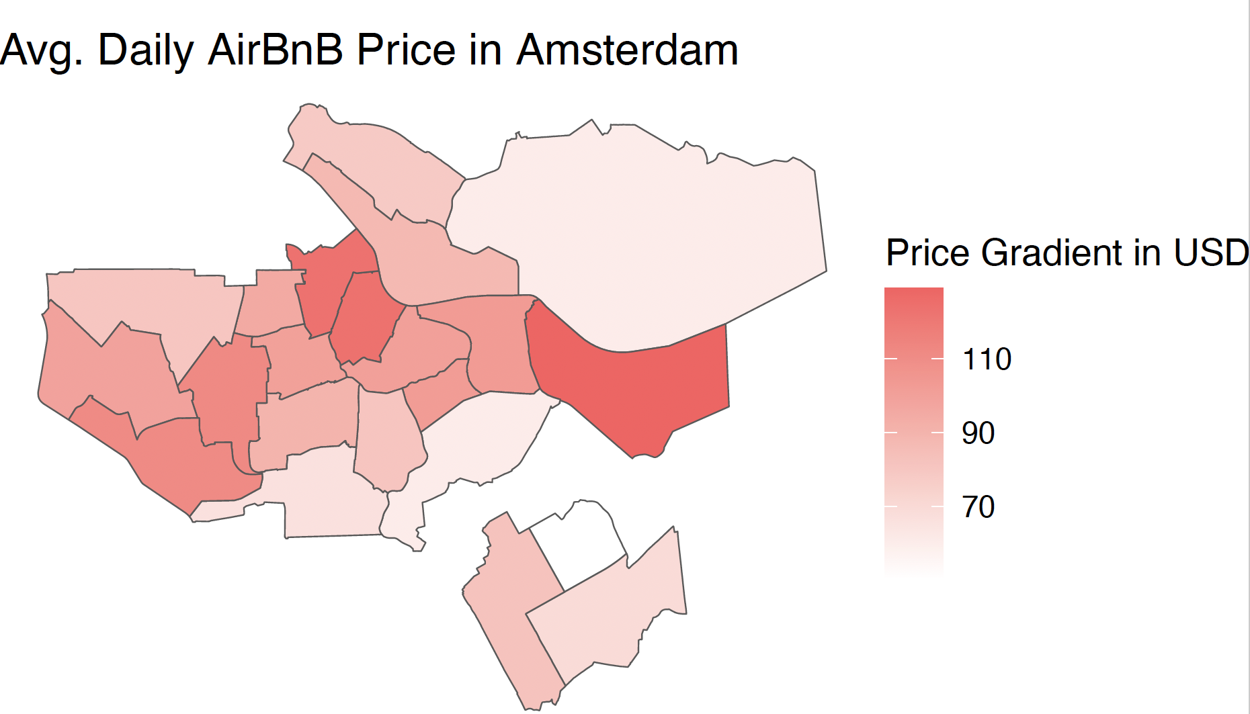
Model Methodologies

Slide 8
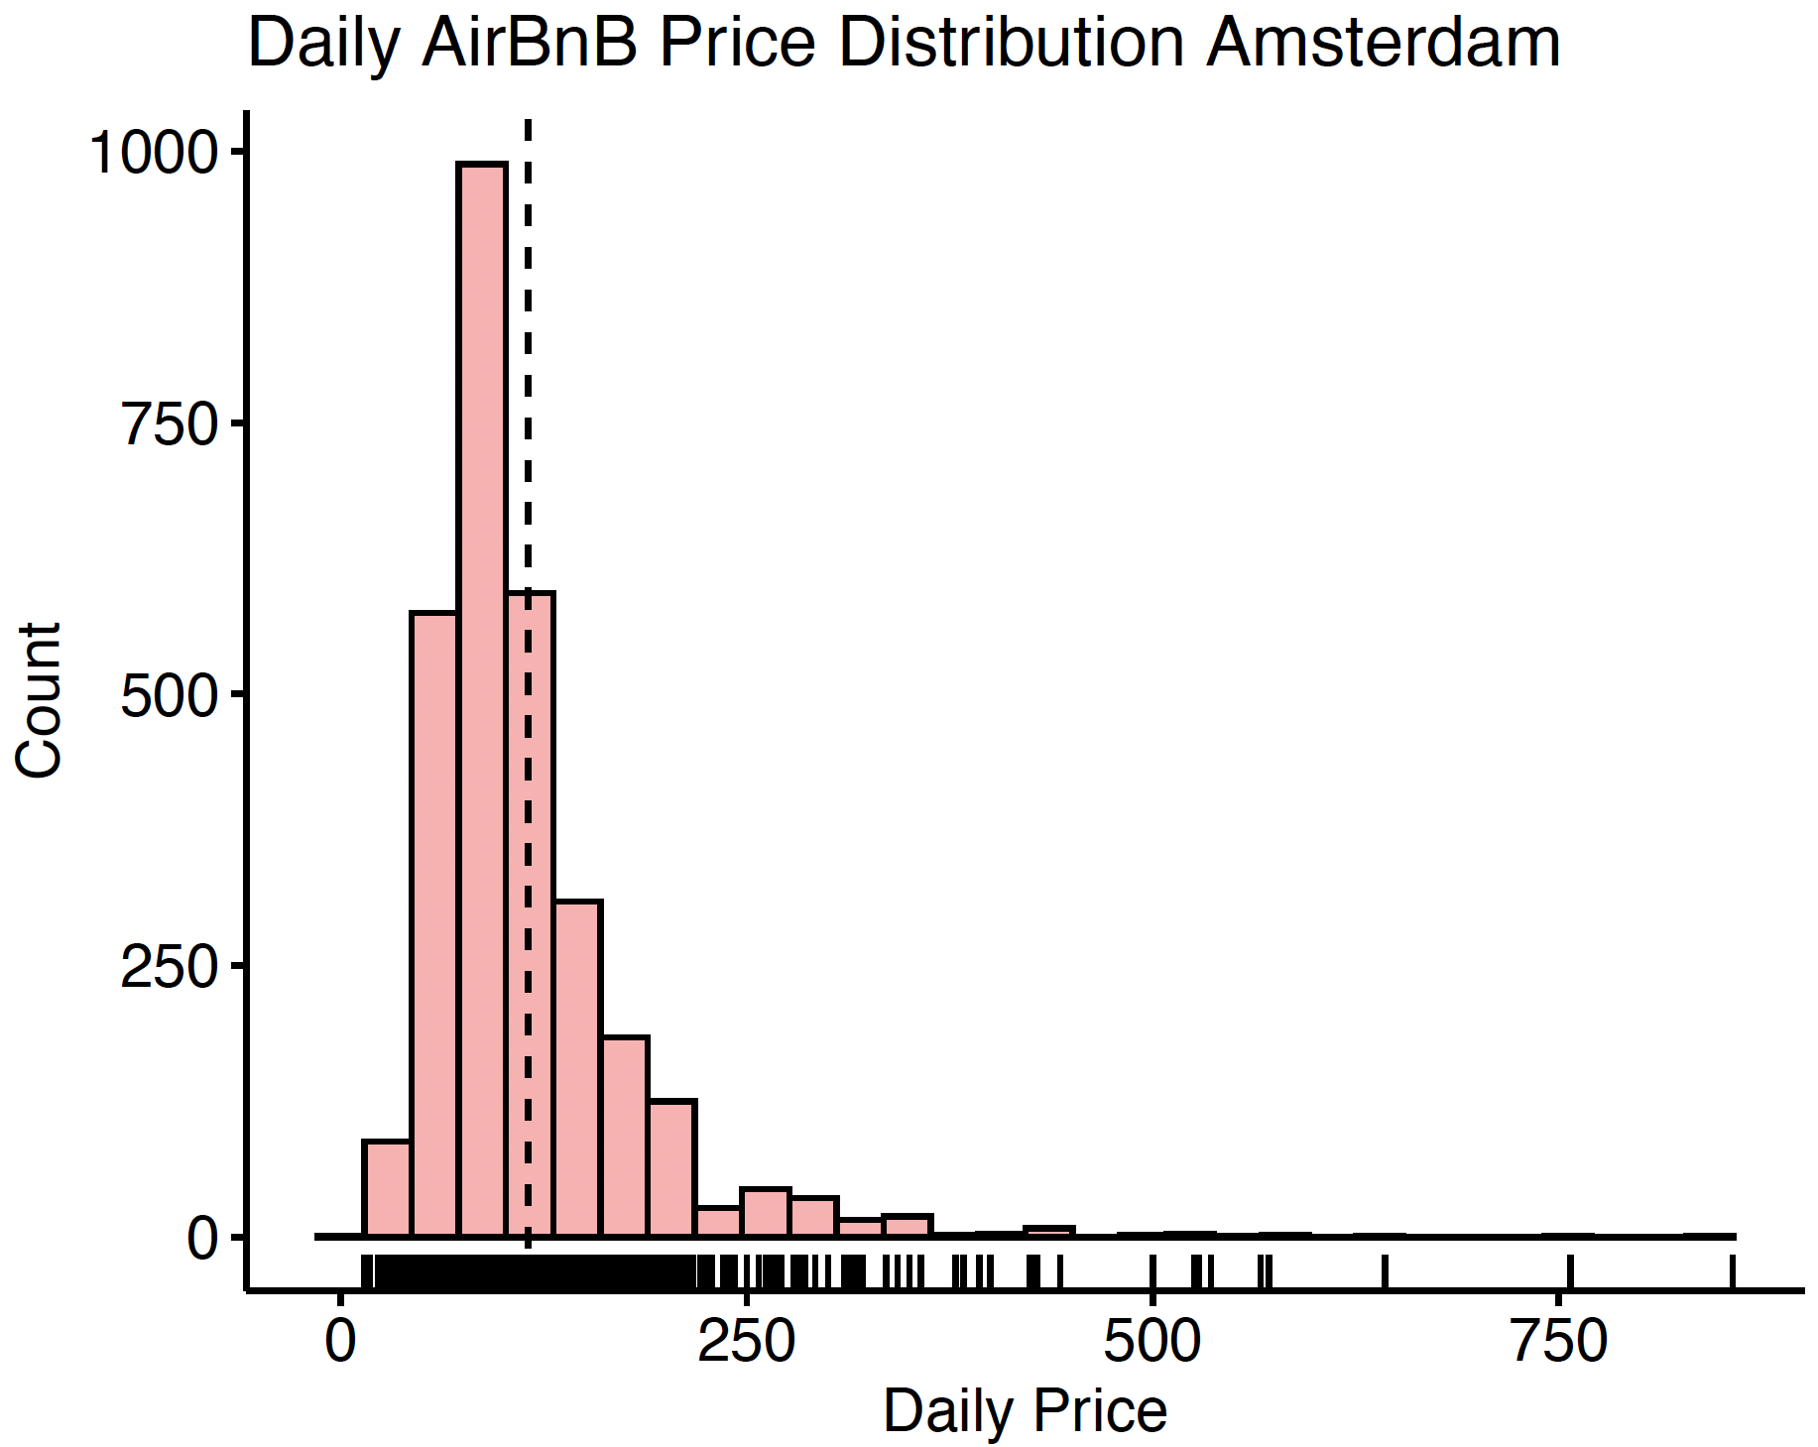
Model Methodologies

Slide 9
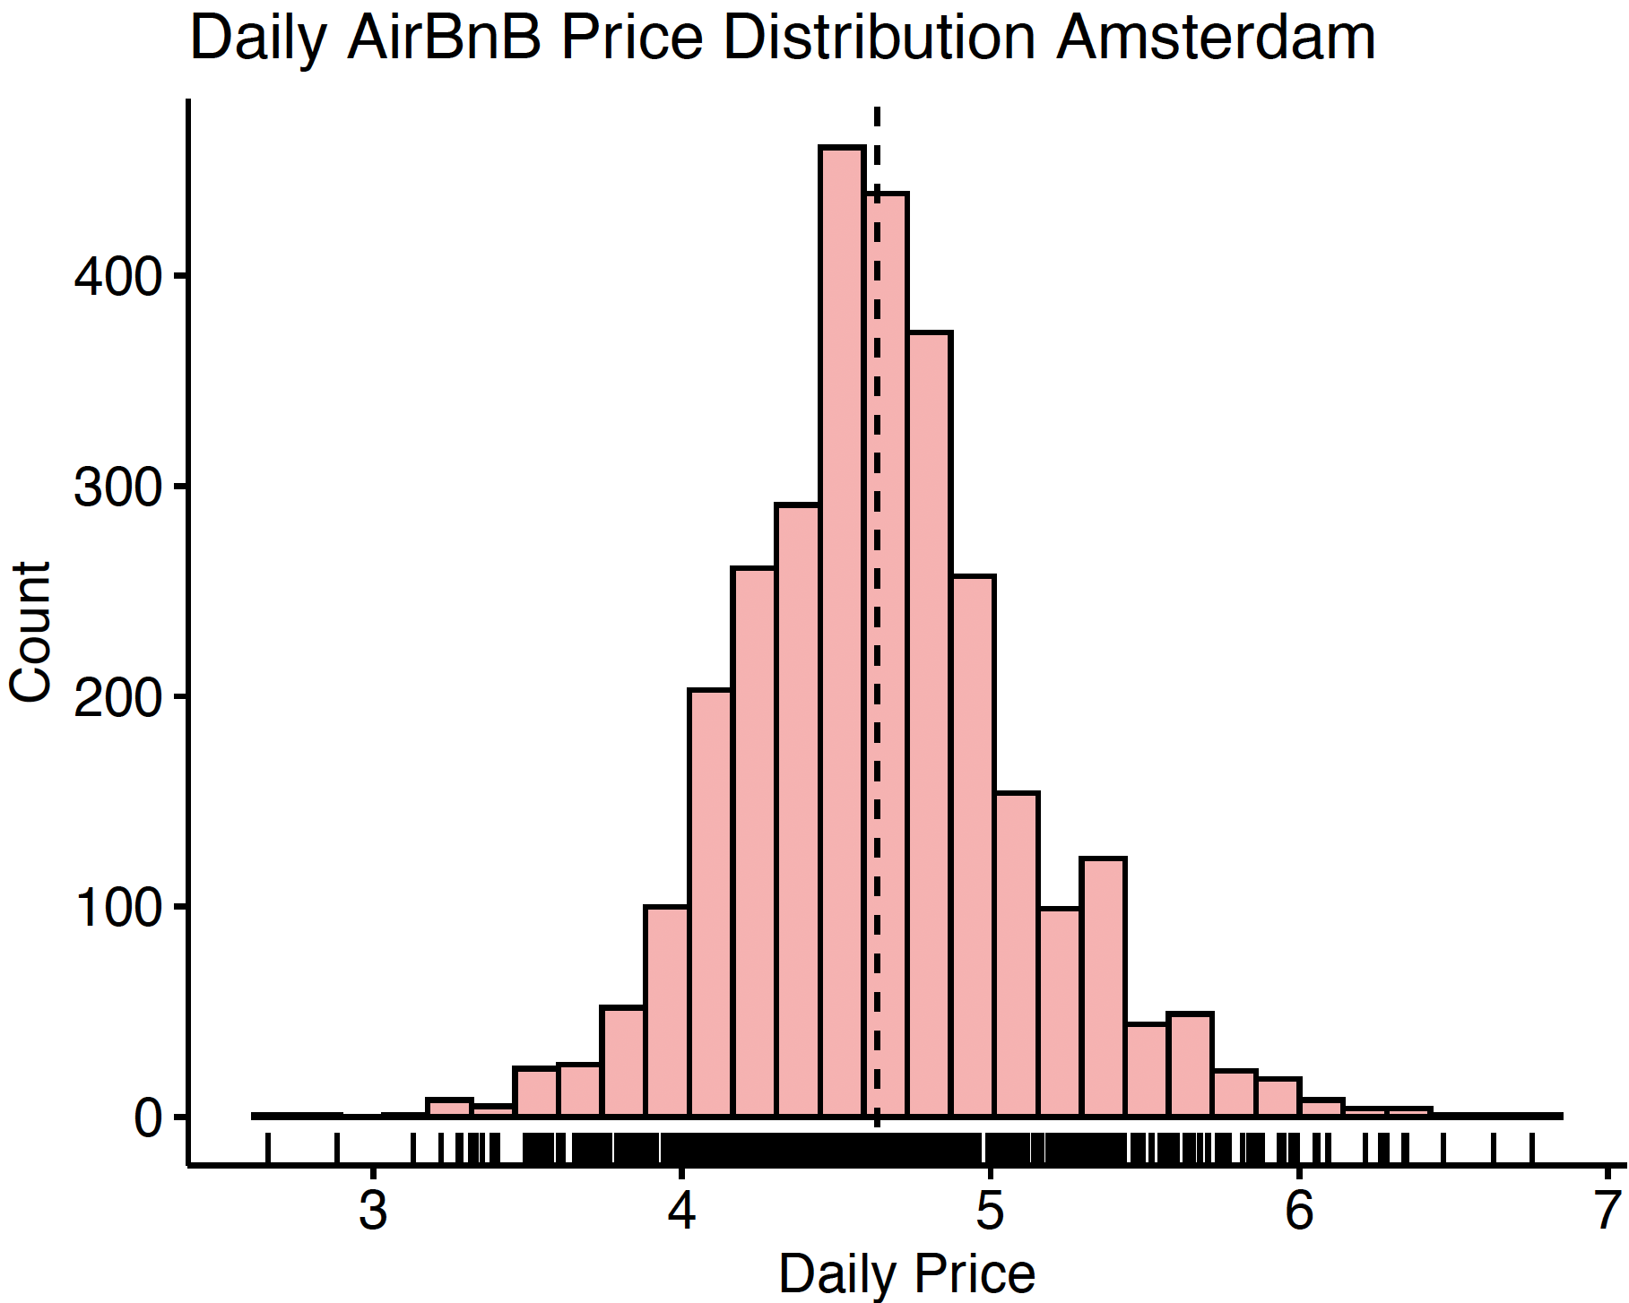
Model Methodologies

Slide 10
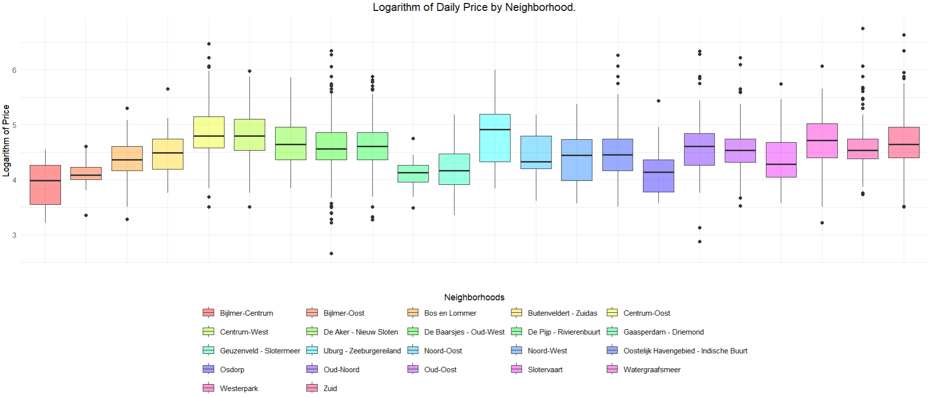
Model Methodologies

Slide 11
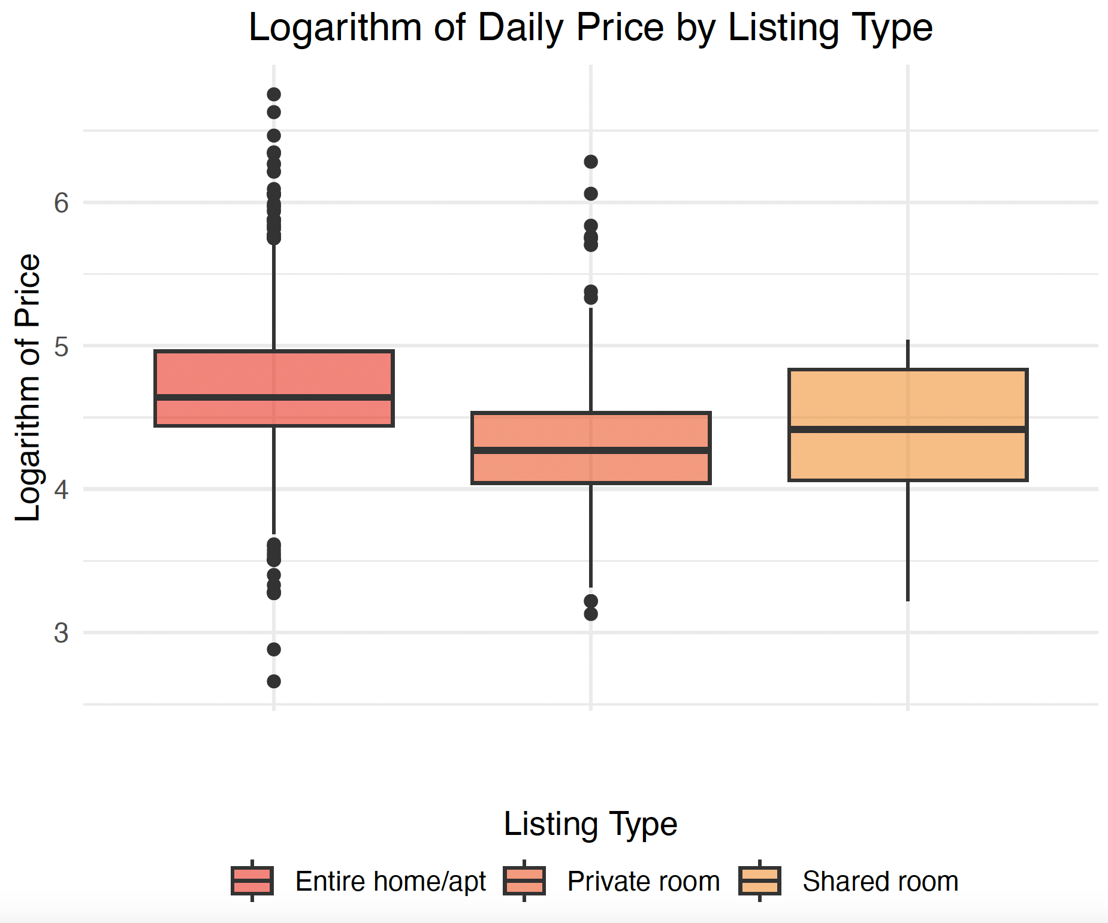
Model Methodologies

Slide 12
Thank You

